Slide 1
US Financial Instituions and Regulations
March, 2015

Slide 2
Table of contents
Overview of US Financial Institutions
Regulators (OCC, FDIC, Fed)
Regulations
1
2
3

Slide 3
Financial Institutions
Types of insitutions:
Commercial Banks
Investment Banks
Insurance Companies
Brokerages / Credit Unions / Shadow Banks

Slide 4
Financial Institutions
Types of insitutions:
Commercial Banks
Investment Banks
Insurance Companies
Brokerages / Credit Unions / Shadow Banks

Slide 5
Financial Institutions
Commercial Banks
A financial institution that provides services, such as accepting deposits, giving loans, and basic investment products like savings accounts and certificates of deposit.

Slide 6


Financial Institutions
Commercial Banks
Deposit cash and savings
Revenue
Lending out and investing deposits
Loans (Business, Auto, Personal)
Mortgages
Revolving Credit (credit cards)
Government debt
Fees on products
Checking account, debit cards
ATMs
Other related services
Mutual Funds
Annuities
Loan deposits back to public
The traditional commercial bank is a brick and mortar institution with tellers, safe deposit boxes, vaults and ATMs.
However, some commercial banks do not have any physical branches and require consumers to complete all transactions by phone or Internet. (Simple Bank, owned by BBVA)

Slide 7

Financial Institutions
Commercial Banks
History
Initially served as safe places to store money/cash.
Pooled wealth from a large number of savers
Then lent it back out to borrowers
Glass Steagall - In 1932 Henry Steagall (from Alabama) introduced a bill that prevented the banks from investing in non-investment trade securities, and only 10% of their income could come from security investments.
Seen as a way to decrease the riskiness of the banks, stemming from the great depression.
Though through the next few decades, courts slowly limited the bill’s effectiveness with their interpretations.
Completely repealed by Congress in 1999.
Modern Day – Now engage in a wide variety of investments and activities, and many have their own investment banking divisions, such as Citibank and JPMorgan Chase.
Since the recession of 2008-2008, Banks are now back at pre-recession (2007) levels of profit.

Slide 8
Financial Institutions
Commercial Banks

Slide 9
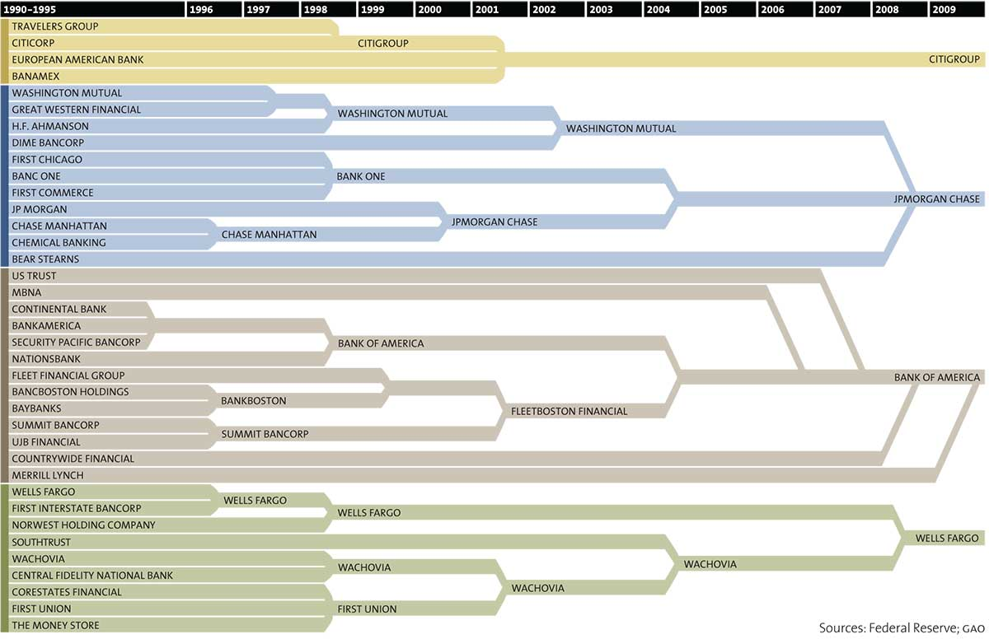
Financial Institutions
Commercial Banks
Consolidation over time
Numerous banks have merged or been bought out over time, creating what is known today as the big 4.

Slide 10
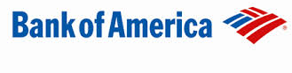


Financial Institutions
Commercial Banks
State
Federal
Chartered in the state of the bank’s headquarters.
May be across state borders (state law dependant).
Under more simple regulation, good for the smaller banks with just one or a few branches.
Under the Office of the Comptroller of the Currency (answers to Fed) and FDIC.
Both can be FDIC member banks with insurance up to $250,000

Slide 11





Financial Institutions
Investment Banks
Initially were just part of commercial banks, but became seperated in 1933. Have slowly become integrated again.
Serve Financial Instruments | Underwriting stocks, IPOs on primary market. Less regulation (SEC, FINRA, Treasury) than commercial banks.
Mergers and Acquisitions | Facilitate mergers between companies. Represents either the buyer or the seller.
Research and financial advising | Analysis of equities and business financials. Provide important reports on businesses can have big effects in the stock market and debt prices.

Slide 12
Financial Institutions
Investment Banks
Divided in Two Halves
Buy-Side
Advising institutions with investment services
Some products of Buy side:
Private equity funds
mutual funds
Trusts
hedge funds
pension
Sell-Side
Trading securities for cash or other securities
Stocks, IPOs on the market
The promotion of securities
Underwriting
Research Reports
Also can be split into private and public functions with an information barrier that separates the two to prevent information from crossing.
Private areas of the bank deal with insider information that may not be publicly disclosed, while public areas such as stock research deal with public information.

Slide 13
Financial Institutions
Investment Banks

Slide 14

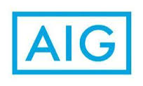


Financial Institutions
Insurance Companies
Insurance Companies
Manage risk
In exchange for premiums (payments) companies will offer to pay a large sum of money later in the case of a specified event.
Auto, Health, Commercial, Home, Disability, etc. . .
Creating Value
By pooling and redistributing risk, consumers can be shielded from calculated or unforseen risks, which could create liquidity or solvency issues if such events are extreme enough.
Early History
Babylonian traders – 2,000bc
Redistributing wares across routes
Code of Hammurabi – lender insurance (vessels)

Slide 15
Financial Institutions
Insurance Companies

Slide 16


Financial Institutions
Other Financial Types
Brokerages
Buying and Selling of Instruments
Securities (stocks), FX, Options
Produce revenue via commission
Full Service / Discount
Full - Provide in-house detailed analysis and research
Discount – DIY, as low as $5 a trade
Credit Unions
Membership restricted, member owned and non-profit.
Better rates on loans and deposits, tend to avoid surprise fees you may find in a typical bank.
Shadow Banking
Hedge Funds, Derivatives, and Unlisted Securities
Creating credit across the globe, but not subject to normal regulation or transparancy. (lack of traditional deposits)
Employ higher risks, not risking their own money
Played a large part in global banking collapse in 2008
Lack of transparency hid extreme risks, while manufacturing lucrative profits.
Eventually, with so much financial leverage, one bad turn of events made many banks insolvent

Slide 17




Financial Institutions
2007-2008
Financial Collapse of 2007-2008
Lack of Transparency
Insufficient Capital
Bad Incentives
Banks began trading heavily in financial derivatives.
Packaged in such a way as to hide true nature (dark pools).
Hid extreme downside risk due to leveraging.
When things got bad, banks were not prepared.
Did not know of risk, therefore did not plan for failure.
These asset values crashed, but liabilities remained.
Solvency became an issue.
Managers get pat on back when doing well, blame market when doing poorly.
Too big to fail (moral hazard)– Propping up of banks by Fed diminishes liability, incentivises future risk taking.

Slide 18


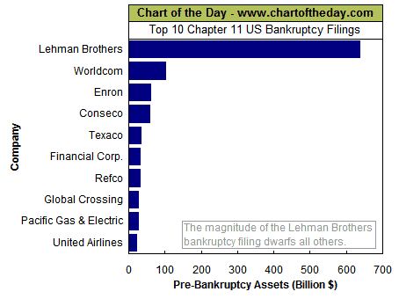
Financial Institutions
Lehman Brothers
Largest Purchaser of Mortgage-Backed Securities
Accumulated $95B in MBS assets, 400% of total equity (bad).
By end of 2007, had a 31 equity ratio!
Assymetric compensation
Employees and managers made large bonuses for performance, but not punished for failures.
Shift burden of losses to shareholders. (No Skin in the Game)
Creditors not worried
Too big to Fail (or not?) - Lenders not worried, were comfortable government would never let a bank collapse, wrong!
Created huge run on investments throughout the global system.

Slide 19
Table of contents
Overview of US Financial Institutions
Regulators (OCC, FDIC, Fed)
Regulations
1
2
3

Slide 20
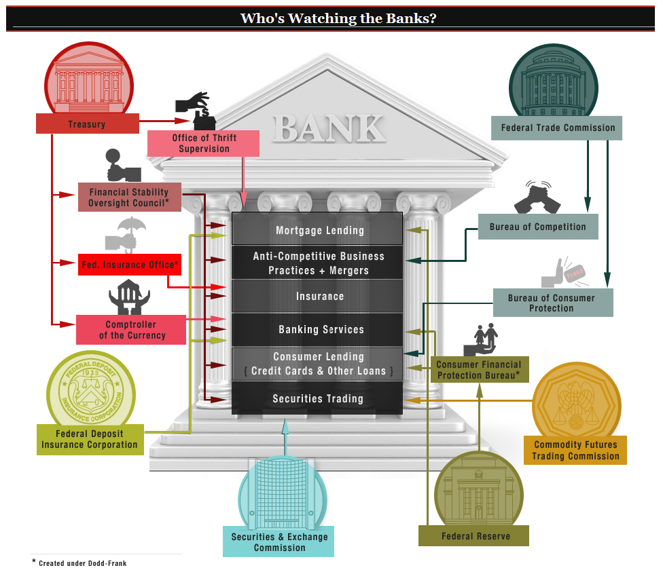
Table of contents
Regulators

Slide 21
Table of contents
Overview of US Financial Institutions
Regulators (OCC, FDIC, Fed)
Regulations
1
2
3

Slide 22
Financial Institutions
Main Regulations
BASEL II/III
Liquidity
Capital
Stress Testing
Dodd/Frank legislation
Volker Rule
Whistleblowing
End “Too Big to Fail”
CCAR
Stress Testing
Capital Requirements
Regulatory Reporting
Records Keeping
Sarbanes Oxley
Corporate Filings
Fraud
Records Keeping

Slide 23
Financial Institutions
Dodd-Frank
(Wall street reform and consumer protection act)
Collection of regulations on financial instituions implemented in 2010.
Why? - Response to the issues that came up in the recession of 2007-2008
Goal of lowering risk by monitoring activities of banks as well as active efforts to increase certain aspects such as liquidity and capital reserves.
Established new agencies such as the Financial Stability Oversight Council and the Orderly Liquidation Authority
Volcker Rule – Restricts thje way banks can invest in trading and derivatives

Slide 24
Financial Institutions
Basel
BASEL (I,II,III)
The Basel Committee was formed in 1974 by the Group of Ten, to develop guidelines for bank regulations and best practices recommendations.
1988 | 2004 | 2015-2019
BASEL I | BASEL II | BASEL III
Contains a set of agreements set by the Basel Committee on Bank Supervision (BCBS),
Recommendations on regulations in regards to capital, market, and operational risk.
The goal of the accords is to ensure that financial institutions have enough capital on account to meet obligations and absorb unexpected losses.
Not binding, more of a general guidance to central banks on how to govern.

Slide 25
Financial Institutions
Basel
BASEL I
The first global BASEL accord was createdin 1988. It’s goal was to:
Strengthen the stability of the international banking system.
Set up a fair and consistent global baking system in order to decrease competitive inequality among international banks.
Primarily focused on credit risk and appropriate risk-weighting of assets. Assets of banks were classified and grouped in five categories according to credit risk, carrying risk weights of:
0% (for example cash, gold, home country debt like Treasuries),
20% (securitisations such as mortgage-backed securities (MBS) with the highest AAA rating),
50% (municipal revenue bonds, residential mortgages),
100% (for example, most corporate debt),

Slide 26
Financial Institutions
Basel
BASEL II
Minimum Capital Requirements
Supervisory Review Process
Market Discipline
Calculation of minimum capital requirements
Capital Adequancy Assesment
Disclosure Requirements
Transparency for market participants
Enhanced comparability among banks
Public dislosure requirements
Operational Risk
Credit Risk
Operational Risk
Market Risk
Supervisory Review Process
Internal Systems
Risk Profile
Compliance
Capital Allocation

Slide 27
Financial Institutions
Basel
BASEL II
Minimum Capital Requirements
Basel I only initially accounted for credit risk of the institutions. Basel II implemented market risk as well as operational risk.
Banks must hold 8% of their assets as capital, after adjusting their assets for risk.
But the banks may relay on their own Internal Ratings-Based (IRB) approach to creating a risk profile for their credit.
Once they have classified their assets and assigned risk profile, they arrive at a final Risk Weighted Assets (RWA) number that is used to reach the 8% capital requirement
Calculation of minimum capital requirements
Credit Risk
Operational Risk
Market Risk

Slide 28
Financial Institutions
Basel
BASEL II
Supervisory Review Process
Banks are encouraged to continuously improve their internal procedures for assessing their risk situation and the adequacy of their capital.
The same applies to ongoing adjustment and development of new methods of risk management and internal control.
Designed to look at risk areas that are not taken into account when computing the minimum capital requirements.
Such as interest rates in the market and uncertainties in measuring operational risks
Capital Adequancy Assesment
Operational Risk
Supervisory Review Process
Internal Systems
Risk Profile
Compliance
Capital Allocation
Supervisors should seek to intervene to prevent capital from falling below the minimum levels required and should require rapid remedial action if capital is not maintained or restored.

Slide 29
Financial Institutions
Basel
BASEL II
Market Discipline
Release relevant financial data (financial statements etc.) in a timely fashion to the public, for example, through the webpage.
This will enable depositors to better evaluate bank condition (i.e. bank probability of failure) and diversify their portfolio accordingly.
The idea is to lead to more easy comparisons across banks by consumers and investors, creating a more transparent presentation of their financials.
Disclosure Requirements
Transparency for market participants
Enhanced comparability among banks
Public dislosure requirements

Slide 30
History of the Regulations
Stress Testing

Slide 31
History of the Regulations
Sarbanes Oxley

Slide 32
2015 CCAR Results

Slide 33
Financial Institutions
Bank Responses
Over-regulation?
Cyclical Smoothing
Increasing tepid lending in recession (capital requirements)

